Slide 1
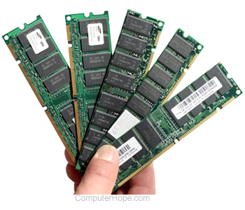
TYPES OF MEMORIES
BY : -
RITESH GOYAL
AAZAIN SHAH
TANISHQ CHAUHAN
SACHIN PRAJAPATI
MAAZ AHMED
TARUN KUMAR AHIRWAR

Slide 2
WHAT IS MEMORY ?
A memory is just like a human brain. It is used to store data and instructions.
Computer memory is the storage space in the computer, where data is to be processed and instructions required for processing are stored.
The memory is divided into large number of small parts called cells.
Each location or cell has a unique address, which varies from zero to memory size minus one.

Slide 3
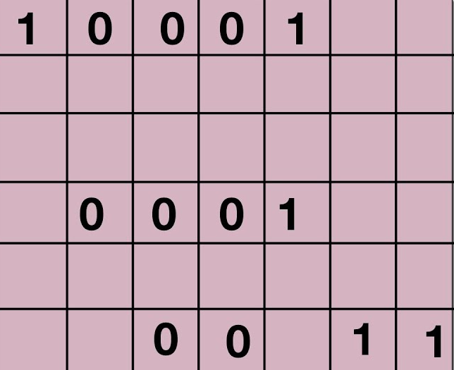
REPRESENTATION OF MEMORY IN THE FORM OF CELLS

Slide 4
CLASSIFICATIONS OF MEMORY

Slide 5
PRIMARY MEMORY (RAM & ROM)
RAM ( RANDOM ACCESS MEMORY )
RAM is a volatile memory which could store the data as long as the power is supplied.
The CPU can access the data stored on it.
It is used to store the data that has to be currently processed by CPU temporarily.

Slide 6
PRIMARY MEMORY (RAM & ROM)
ROM ( READ ONLY MEMORY )
ROM is a non-volatile memory which could retain the data even when power is turned off.
The CPU can’t access the data directly stored in ROM.
It stores the instructions required during booting process of the computer.
The memory from which we can only read but cannot write on it.

Slide 7
TYPES OF RAM
SRAM ( STATIC RAM )
The word static indicates that the memory retains its contents as long as power is being supplied. However, data is lost when the power gets down due to volatile nature.
SRAM chips use a matrix of 6-transistors and no capacitors.
Transistors do not require power to prevent leakage, so SRAM need not be refreshed on a regular basis.
There is extra space in the matrix, hence SRAM uses more chips than DRAM for the same amount of storage space, making the manufacturing costs higher.
SRAM is thus used as cache memory and has very fast access.

Slide 8
TYPES OF RAM
CHARACTERSTICS OF SRAM
Long life
No need to refresh
Faster
Used as cache memory
Large size
Expensive
High power consumption

Slide 9
TYPES OF RAM
DRAM ( DYNAMIC RAM )
DRAM, unlike SRAM, must be continually refreshed in order to maintain the data.
This is done by placing the memory on a refresh circuit that rewrites the data several hundred times per second.
DRAM is used for most system memory as it is cheap and small.
All DRAMs are made up of memory cells, which are composed of one capacitor and one transistor.

Slide 10
TYPES OF RAM
CHARACTERSTICS OF DRAM
Short data lifetime
Needs to be refreshed continuously
Slower as compared to SRAM
Used as RAM
Smaller in size
Less expensive
Less power consumption

Slide 11
TYPES OF ROM
PROM ( PROGRAMMABLE READ ONLY MEMORY)
PROM is a blank version of ROM.
It is manufactured as blank memory and programmed after manufacturing. We can say that it is kept blank at the time of manufacturing.
You can purchase and then program it once using a special tool called a programmer.
Once it is programmed, the data cannot be modified later, so it is also called as one-time programmable device.

Slide 12
TYPES OF ROM
EPROM ( ERASABLE & PROGRAMMABLE READ ONLY MEMORY)
EPROM is a type of ROM that can be reprogrammed and erased many times.
EPROM can be erased by exposing it to ultra-violet light for a duration of up to 40 minutes.
So, it retains its content until it is exposed to the ultraviolet light. You need a special device called a PROM programmer or PROM burner to reprogram the EPROM.

Slide 13
TYPES OF ROM
EEPROM (Electrically Erasable and Programmable Read Only Memory)
EEPROM is programmed and erased electrically.
It is erased and reprogrammed electrically without using ultraviolet light.
The BIOS of a computer is stored in this memory.
EEPROM can be erased one byte at a time, rather than erasing the entire chip.

Slide 14
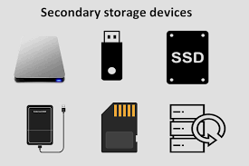
Secondary Storage
A storage medium that holds information until it is deleted or overwritten.
This section of storage is also referred to as backup storage.
The storage capacity of primary storage is not sufficient to store the large volume so secondary storage.
The secondary memory is accessed indirectly via input/output operations.
This memory is also called backup storage or mass storage media.

Slide 15
Distinguishing Characteristics of Secondary Storage
As we examine some secondary storage media, look out for the following:
Capacity
Access Method
Access Speed
Portability

Slide 16
Types of Secondary Memory
Secondary memory is of two types:
Fixed Storage
Removable Storage

Slide 17
Fixed Storage
A fixed storage is an internal media device that is used to store data in a computer system.
Generally, the data of the computer system is stored in a built-in fixed storage device.
Following are Fixed Storage devices:
Internal Flash Memory
Hard Disk Drives (HDD)
SSD (Solid-State Disk)

Slide 18
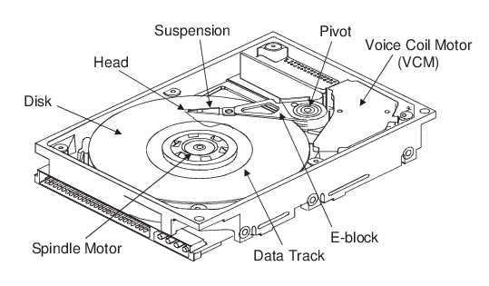
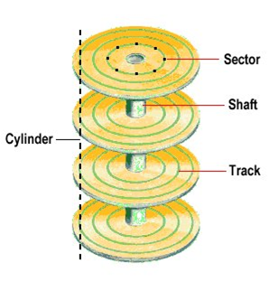
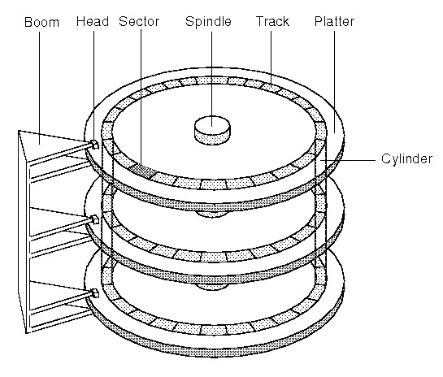
Hard Disk Drives (HDD)
Hard Disk was introduced and patented in the year 1956 in IBM’s San Jose, California laboratory.
It is a rigid magnetic disc that is used to store data.
It is located within the drive unit.
Hard disks or hard disk drives come in different storage capacities(like 256 GB, 500 GB, 1 TB, and 2 TB, etc.).

Slide 19
Advantages
Disadvantages
One of the significant advantages of a Hard Disk drive is that its cost is low.
Another advantage of a Hard Disk is that it is readily available in the market.
Hard Disk is faster than optical disks.
The capacity for storing the data in HDDs is large.
The speed of reading and writing in HDD is slower than the RAM.
HDDs are noisy.
Another disadvantage of HDD is energy inefficiency.
HDDs consume more power.
The form factor of HDDs is heavier than the SSDs.

Slide 20
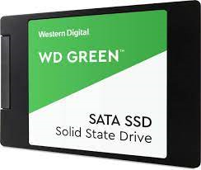
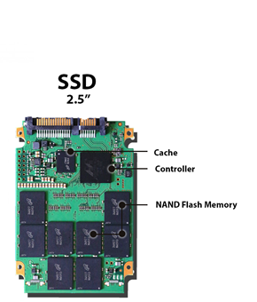
Solid-State Drive: (SDD)
SSD (Solid State Drive) is also a non-volatile storage medium that is used to hold and access data.
Solid-state drive (SSD) is a solid-state storage device that uses integrated circuit assemblies as memory to store data.
It is more expensive.
These storage devices store the data in the semiconductor cells.

Slide 21
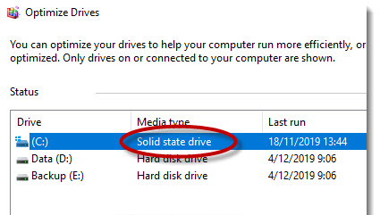
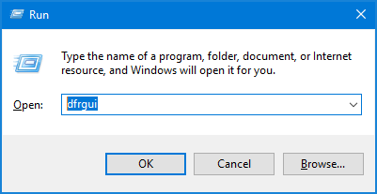
Questions
Que. How do we know we have both SSD and HDD in our laptops?
Que. Can we use both SSD and HDD?

Slide 22
Removable Storage
In secondary memory, removable storage is an external media device that is used to store data in a computer system.
It is a storage device that can be inserted or removed from the computer according to our requirements.
Following are Removable Storage devices:
Floppy disks
Magnetic tapes
Disk packs
Memory cards
Optical discs (like CDs, DVDs, Blu-ray discs, etc.)

Slide 23
USB Flash Drive
A USB flash drive is a data storage device that includes flash memory with an integrated USB interface. It is typically removable, rewritable and much smaller than an optical disc.
USB flash drives are often used for storage, data back-up and transferring of computer files. Compared with floppy disks or CDs, they are smaller, faster, have significantly more capacity, and are more durable due to a lack of moving parts.
Additionally, they are immune to electromagnetic interference (unlike floppy disks), and are unharmed by surface scratches (unlike CDs).

Slide 24
USB Specifications
There are three main USB specifications that USB flash drives can connect through: 1.0, 2.0 and 3.0. Each specification publication allows for faster data transfer rates than the previous version. There have also been several prereleases and various updates in addition to these three versions.
USB 1.0 was released in January 1996. It was available in two versions:
a) USB 1.0 low-speed: Provides a data transfer rate of 1.5 megabits per second (Mbps).
b) USB 1.0 high-speed: Has a data transfer rate of 12 Mbps.

Slide 25
USB Specifications
USB 2.0, also known as hi-speed USB, was developed by Intel and Microsoft was introduced in 2001. Hi-Speed USB is capable of supporting a transfer rate of up to 480 megabits per second (Mbps), or 60 megabytes per second (MBps).
USB 3.0, also known as SuperSpeed USB,USB 3.0 improved upon the USB 2.0 technology with speed and performance increases, improved power management and increased bandwidth capability. It provides two unidirectional data paths for receiving and sending data at the same time. USB 3.0 supports transfer rates up to 5.0 gigabits per second (Gbps), or 640 megabytes per second (MBps).

Slide 26
Compact Disk (CD)
CDs or Compact Disks are optic readable media. CDs are the replacement of the phonograph disc. The main material of the CD is plastic. The shape of the plastic is circular and one side of the circular plastic is coated with the reflecting metal coating, usually aluminum.
1) The standard diameter of a CD is 120mm and thickness is 1.2mm.
2) CDs can store many types of data, like audio, video, games, any documents, etc.
3) The storage capacity of CDs are very less as compare to HDD or DVD that is 700MB.

Slide 27
Compact Disk (CD)
4) The data of cd are read in the form of pits and each pits is of 0.83- micrometer.
5) The hole is in the center of the CD, which diameter is 15mm. The area closest to the hole is known as the clamping area, no data is stored in this area because there is no metallic layer.

Slide 28
TYPES OF COMPACT DISKS
There are three types of CDs available:
a) CD-R (Compact Disc – Recordable): This type of compact disc can be written only once and can not erased.
b) CD-ROM (Compact Disk-Read Only Memory): This disks are read once, after read it is use as a ROM, that is cannot be updated later.
c) CD-RW (Compact Disc-ReWritable): This type of compact disc can be written multiple times and can be erased also.

Slide 29
Cache Memory
The data or content of the main memory that are used frequently by
CPU are stored in the cache memory so that the processor can easily
access that data in a shorter time.
Cache memory placed between main memory and CPU.
The performance of the cache memory frequently measured in terms of
a quantity is called hit ratio .
When the CPU refers to memory and finds the word in cache, it is said
produce hit.
If the word is not found in the cache, it is in main memory and it count as
a miss.

Slide 30
Types of Cache
L1: In this types of cache memory, a small amount of memory is present the CPU itself.
L2: the level cache may be inside the CPU and outside the CPU all the cores of a CPU have their own separate level 2 cache, in case it s outside the CPU, it is connected with the CPU with very high speed bus.
L3: This cache is used to enhance the performance of the L1 and L2 cache. It is allocated outside the CPU and is shared all the cores of a CPU.

Slide 31
Advantages
Cache memory is must faster than primary memory and secondary memory.
The data access time of cache memory less than primary memory.
It stores all the data and instructions frequently use by the CPU, thereby
increasing the performance of the CPU.

Slide 32
Disadvantages
It is must more expensive than the rest of the memory.
Its storage capacity quite handy.
It stores data temporary.

Slide 33
Thank you For Listening us.

